Slide 1
Et Tu Brute?
Unit 4.2
Cybersecurity Boot Camp |

Slide 2

Today’s Class
This week, we’ll be diving deeper into the field of Cryptography and Encryption.
Notes:
Review goals; address any questions.

Slide 3

Today’s Class
Today’s class will be heavy on definitions – take it seriously! Being able to speak with in the vernacular of cybersecurity professionals is critical in this career.
Notes:
Review goals; address any questions.

Slide 4
Today’s Goals
By the end of class, you will be able to:
Articulate the fundamental goals of cryptography and the mechanisms by which strong ciphers achieve them.
Explain the concept of cryptographic strength and its relationship to the size of a cipher’s key space.
Recognize the most common cryptosystems and further articulate a few of their strengths and weaknesses.
Speak proficiently about situations surrounding the cryptography space to technical and non-technical audiences.
Notes:
Review goals; address any questions.

Slide 5
Let’s start with a warm-up.

Slide 6
Activity: Defining the Key Terms (5 minutes)
With the person next to you, define each of the following:
Cryptography
Encryption
Key
Cipher
Plaintext
Ciphertext

Slide 7
Activity: Decipher the Advice (10 minutes)
The below message has been encrypted using the Caesar Cipher. Using only a pencil and paper and the following information uncover the hidden message:
Message:
“cfjoh bcmf up csfbl tfdvsjuz epfto’u nblf zpv b ibdlfs boznpsf uibo cfjoh bcmf up ipuxjsf dbst nblft zpv bo bvupnpujwf fohjoffs.”
Shift Key: 1

Slide 8
Answer:
“Being able to break security doesn’t make you a hacker anymore than being able to hotwire cars makes you an automotive engineer.”

Slide 9
Activity: How to Crack the Message (5 minutes)
Let’s say you had the below message and did not know the key. How might we retrieve the key and message?
Message:
“cfjoh bcmf up csfbl tfdvsjuz epfto’u nblf zpv b ibdlfs boznpsf uibo cfjoh bcmf up ipuxjsf dbst nblft zpv bo bvupnpujwf fohjoffs.”

Slide 10
How to Crack the Message
Option 1: nkgjkj zu znk xobkx lux g yuru bgige. ykk eua rgzkx!
Option 2: mjfiji yt ymj wnajw ktw f xtqt afhfd. xjj dtz qfyjw!
Option 3: liehih xs xli vmziv jsv e wsps zegec. wii csy pexiv!
Option 4: khdghg wr wkh ulyhu iru d vror ydfdb. vhh brx odwhu!
Option 5: jgcfgf vq vjg tkxgt hqt c uqnq xceca. ugg aqw ncvgt!
Option 6: ifbefe up uif sjwfs gps b tpmp wbdbz. tff zpv mbufs!
Option 7: headed to the river for a solo vacay. see you later!
Option 8: gdzcdc sn sgd qhudq enq z rnkn uzbzx. rdd xnt kzsdq!
Option 9: fcybcb rm rfc pgtcp dmp y qmjm tyayw. qcc wms jyrcp!
Try all the combinations!!!
(Brute Force)

Slide 11
Activity: Re-Examining Public Private Key (10 minutes)
Answer the following questions to the person next to you surrounding the diagram in the next slide:
In language as concise as possible, what is happening in this diagram?
Why are we using separate public and private keys? What role do each of the keys play?
Where would we commonly use the public private key relationship?
What about this diagram remains confusing to you? (List as many questions as possible)
Hint:
Force yourself to lean into the confusion! It’s important to articulate what you don’t understand to reach insight!

Slide 12
Activity: Re-Examining Public Private Key (10 minutes)

Slide 13
Activity: Today’s Definitions (5 Minutes)
For the first few minutes of class, research and define each of the following terms. Share your answers with the person next to you:
Block Cipher
Stream Cipher
Symmetric Encryption
Asymmetric Encryption
Key Space
Cryptanalysis
Note: Don’t worry. We’ll go into more depth throughout class today.

Slide 14
Pillars of Cryptography

Slide 15
Goals of Security = CIA Triad
Notes:
Review goals; address any questions.

Slide 16
Goals of Cryptography = PAIN
P - Privacy
Definition:
Example:
A - Authentication
Definition:
Example:
I - Integrity
Definition:
Example:
Definition:
N- Non-Repudiation
Example:
While CIA Triad dominates all of security, PAIN is often used to describe the core focus areas of Cryptography.
Notes:
Review goals; address any questions.

Slide 17
Activity: Defining PAIN (12 Minutes)
Take a few moments to:
Define the elements of PAIN (Privacy, Authentication, Integrity, and Non-Repudiation).
Provide an example of each element of PAIN being protected and/or breached.

Slide 18
Goals of Cryptography = PAIN… Defined
P - Privacy
Definition: Ensure no one can read sensitive information
Example: Encrypting psychiatric records so only doctors know your diagnoses
A - Authentication
Definition: Ensure messages come from who you expect
Example: The President uses a special seal to sign bills
I - Integrity
Definition: Ensure your message don’t change in flight
Example: Using checksums to verify that the file you downloaded is the file you thought you downloaded
Definition: Ensure you can’t deny you sent a message after you've sent it
N- Non-Repudiation
Example: Using your signature on a contract means you can't renege on the contract
Know these terms!
Notes:
Review goals; address any questions.

Slide 19
PAIN in Plain English…
In the Context of Cryptography
PAIN translates to…
Preventing Encrypted Data from Being Decrypted
Preventing Encryption Keys from Being Retrieved
Preventing the Presence of Data from Being Known
Notes:
Review goals; address any questions.

Slide 20
The Formula For PAIN
PAIN Goals
Privacy, Authentication, Integrity, Non-Repudiation
Cryptography
Strong cryptography is a core component of the modern IT security infrastructure in maintaining PAIN.
Notes:
Review goals; address any questions.

Slide 21
The Formula For PAIN
PAIN Goals
Privacy, Authentication, Integrity, Non-Repudiation
Confusion
Diffusion
Strong cryptography relies on two core concepts confusion and diffusion to ensure that its encryption mechanisms achieve these goals.
Notes:
Review goals; address any questions.

Slide 22
Activity: Researching the PAIN Formula (8 Minutes)
You know the drill.
Take a few moment to break down the terms: Confusion and Diffusion in the context of cryptography.
Try to arrive at a point where you can clearly articulate what makes each of these different from one another.

Slide 23
The Formula For PAIN… Defined
Confusion
Confusion
Making the steps involved from converting between plain text and cipher text as complicated as possible.
Diffusion
Diffusion
Ensuring the conversion between plain text and cipher text involves distribution of change.
Notes:
Review goals; address any questions.

Slide 24
The Formula For PAIN… Defined
SAY WHAT????
Confusion
Confusion
Making the steps involved from converting between plain text and cipher text as complicated as possible.
Diffusion
Diffusion
Making the conversion between plain text and cipher text involves distribution of change.
Notes:
Review goals; address any questions.

Slide 25
Confusion and Diffusion Example
Plain Text
Caesar (Shift 1)
Cipher Text
CAT
Cipher
ECV
Let’s start with a simple example
How might we make this more complex?
Notes:
Review goals; address any questions.

Slide 26
Confusion and Diffusion Example
Vigenere
Shift Letter 1 by 3
Shift Letter 2 by 4
Shift Letter 3 by 9
Plain Text
Cipher Text
CAT
Cipher
fec
Add Confusion
In this example, we process our plain text through multiple stages. Each letter is translated using a different key. These added steps are a classic example of confusion.
Notes:
Review goals; address any questions.

Slide 27
Confusion and Diffusion Example
Vigenere
Shift Letter 1 by 3
Shift Letter 2 by 4
Shift Letter 3 by 9
Plain Text
Cipher Text
CAT
Cipher
EVC
Add Confusion
Quick Activity:
Why is this harder to brute force?
Notes:
Review goals; address any questions.

Slide 28
Confusion and Diffusion Example
Plain Text
Cipher Text
Encryption
CAT
Cipher
fec
HAT
Cipher
1fd
Add Diffusion
In this example, we’ve added diffusion such that the pattern that held to one bit does not apply to another bit. As messages are made longer the impact of randomness is distributed.
Notes:
Review goals; address any questions.

Slide 29
Confusion and Diffusion Example
Plain Text
Cipher Text
Encryption
CAT
Cipher
fec
HAT
Cipher
1fd
Add Diffusion
Quick Activity:
Why is this harder to brute force?
Notes:
Review goals; address any questions.

Slide 30

Confused? In Pain?
Don’t worry about it! Modern cryptography systems handle this for you. This is why cryptography is best left to standards and experts. But it’s important to understand the broad concepts!

Slide 31
Cryptographic Strength

Slide 32
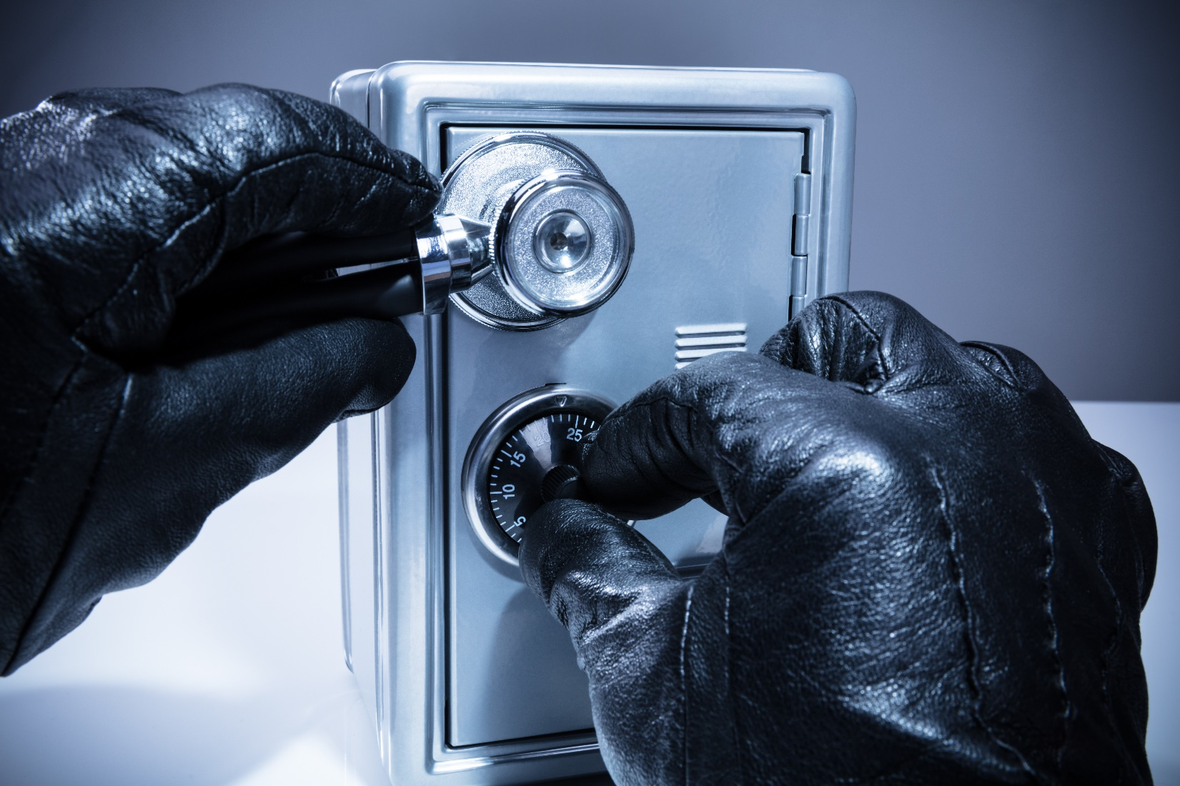
Defining Cryptographic Strength
Like passwords, the strength of a cipher can be measured on the basis of how quickly it can be cracked through brute force.
Notes:
Review goals; address any questions.

Slide 33
Activity: Measuring Complexity (10 Minutes)
Instructions
Assuming you needed to attempt every combination possible in the below scenarios how many combinations would it take?
3 Letter Word (All Letters, All Lower Case)
4 Letter Word (All Letters, All Lower Case)
4 Letter Word (Upper Case and Lower Case)
4 Alphanumeric Characters
4 Characters (Any on Keyboard)
Hint:
Look into Calculating Combinations

Slide 34
Measuring Complexity (Answered)
3 Letter Word (All Letters, All Lower Case) 26^3 = 17,576
4 Letter Word (All Letters, All Lower Case) 26^4 = 456,976
4 Letter Word (Upper Case and Lower Case) 52^4 = 7,311,616
4 Alphanumeric Characters 62^4 = 14,776,336
4 Characters (Any on Keyboard) 96^4 = 84,934,656
Nearly 5000x more complex.
Notes:
Review goals; address any questions.

Slide 35
The Size of Key Spaces
Possible Key
123
Possible Key
563
Cipher
Possible Key
243
Possible Key
943
Key Space refers to the total number of potential keys that are possible within an encryption system.
Notes:
Review goals; address any questions.

Slide 36
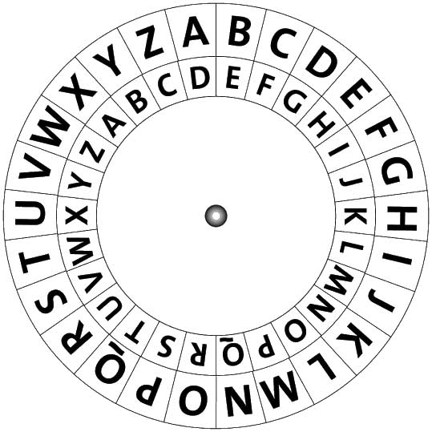
Caesar’s Key Space
Since the possibilities for key shifts align with the alphabet...
The Key Space is: {1 … 25}
(25 different options)
Notes:
Review goals; address any questions.

Slide 37
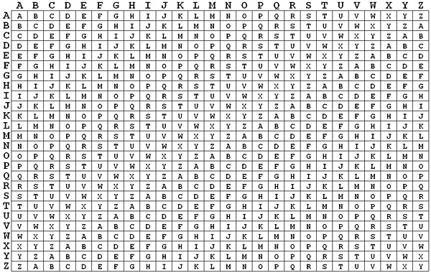
Vigenere’s Key Space
In the Vigenere Cipher, a word is selected as a key.
Each letter of the plain text is shifted according to a corresponding letter of the key.
In essence, it involves multiple rounds of Caesar shifting.
The longer the key, the longer the Key Space.
A key of 10 letters thus has 26^10 options
A key of 100 letters thus has 26^100 options
Notes:
Review goals; address any questions.

Slide 38
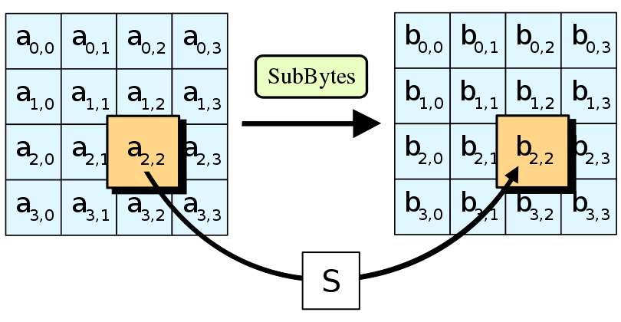
AES’s Key Space
AES the specification established as the standard for encrypting electronic data in the US by the National Institute of Standards and Technology (NIST) has a total key space of 2^256 for a single byte of data. This continues to balloon as the length of data increases.
Notes:
Review goals; address any questions.

Slide 39
Case Studies

Slide 40
Activity: The Breaking of DES (10 Minutes)
Working in groups of three answer the following questions about DES.
What is DES? Who created it? How long has it been around?
In January 1999 DES was publicly broken.
How did this happen?
What was the impact of this to businesses?
What happened in the cryptography space as a result?
At a high-level what were its advantages / disadvantages?

Slide 41
Activity: Miniaturized Cryptography (10 Minutes)
Increasingly there is conversation in the IoT space around the vital need for enhanced cryptography standards.
What is the basis for the call?
What if any incidences of risk have already been identified?
What makes IoT devices unique with regards to their cryptography considerations?
What standards are emerging as a possibility?

Slide 42
Activity: The Quantum Scare (10 Minutes)
Increasingly there has been non-stop talk about the rise of Quantum Computing and its potential risk to the security space.
Spend a few moments researching the concern. What is the basis for it? What are the risks that would emerge if quantum computing occurs?
What are the risk mitigation strategies being taken today to address this possible eventuality?

Slide 43
Activity: AES Break? (10 Minutes)
With your partner play out the following situation:
“Your CEO just walked into your office and started saying: ‘AES was just broken by a group overseas. Should we be concerned?’”
Spend a few moments addressing the following:
Help your CEO understand what AES is and why it matters.
Talk through the steps necessary to assess threats to the company and mitigate risks.
Look for pathways that may be possible as a next step for the company to take.

Slide 44
Activity: Modern Encryption Systems (20 Minutes)
For the next few minutes create a table of 15 different cryptography algorithms online. Look for ones that are highly spoken of online.
Algorithm
Date of Creation
Founders
Type (Asymmetric vs Symmetric)
Advantages
Disadvantages
Date of Break
Article or Story about the Algorithm

